Slide 1
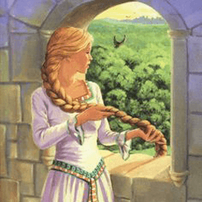
Aditi Vora
~Project 3
Southgate, Vera. Rapunzel. Ladybird, 2006.

Slide 2
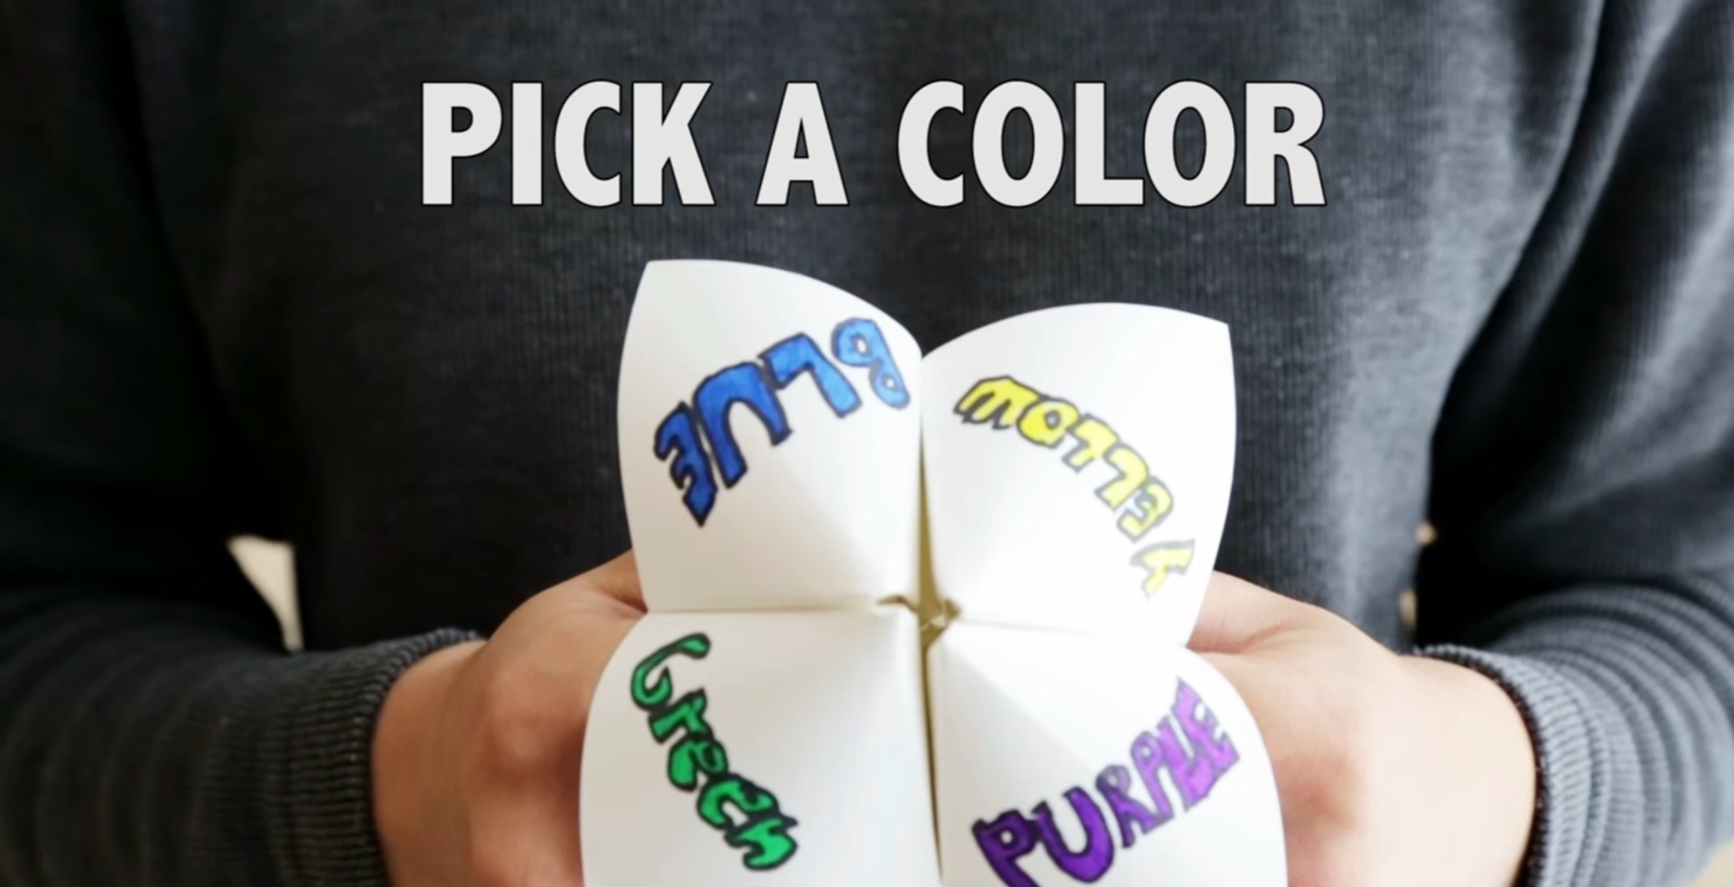
1
2
5
6
--https://www.youtube.com/watch?v=q_Fxnp33fww [0:23-0:34]

Slide 3
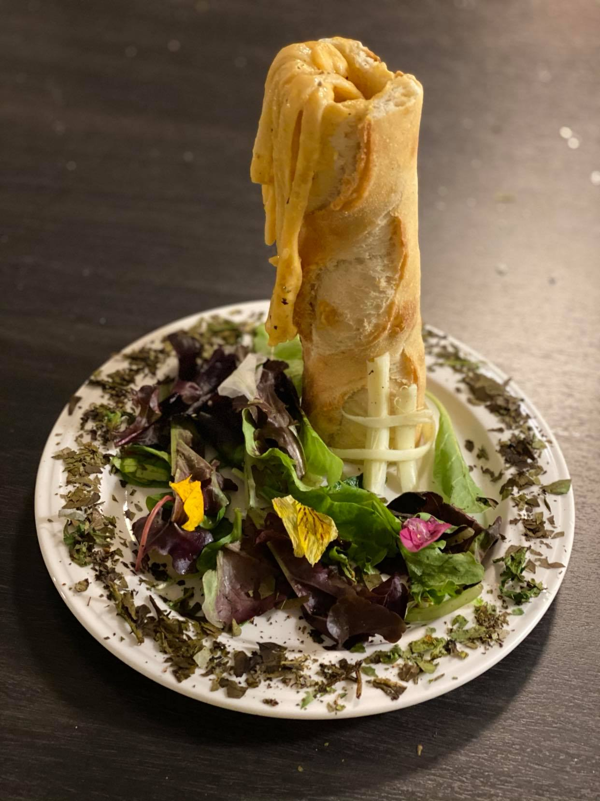
Rapunzel’s Tower
This dish is meant to symbolize Rapunzel’s situation when given the choice to leave her tower.
⇒

Slide 4
For one prong of my project, I decided to write a diary entry from Rapunzel’s perspective. Although she is the protagonist of the tale, we - the readers - don’t get a good sense of who she is, why she does what she does, whether she knows that Mother Gothel isn’t her real mother, etc. On page 290, we are told that she was locked in the tower when she turned 12 and a few years later the prince comes. “A few” generally means 2-4 so we can safely assume that Rapunzel is now somewhere between the ages 14 and 16. By our social standards, she is still considered a child but is only in the process of growing up. Therefore, I believed her reasoning must be complex - full of idealistic dreams and confused emotions about the only parental figure she has ever had. So the diary entry begins by showing just how excited and nervous she was to meet the prince and that their conversation was not merely the prince introducing himself and then proposing, but rather a deeper conversation about their lives. In this interaction, we gain snippets of the lessons that Gothel taught Rapunzel (similar to lessons our parents have always told us) such as stranger danger, how Rapunzel is hers only, etc. While readers understand why Gothel instilled these ideas in her, Rapunzel never thought twice about it.
⇒

Slide 5
Due to this conversation with the prince, Rapunzel feels as though he is the only person who truly understands her and that is the reason she trusts him immediately. The entry then moves on to describe her inner emotional turmoil of whether or not to disappoint who she believes is her mother (although I capitalize “Mother” to show the term is a title for Gothel, not a bond between Rapunzel and her). She reminisces on “the good old days” when she wasn’t locked up and felt she had freedom and she questions why she wasn’t good enough for her mother - why she was locked up. She tries to rationalize her decision based on how Mother Gothel has treated her the past few years and finally ends the entry by convincing herself that it is the right decision to leave and hoping she’s right about the prince truly loving her, unlike Gothel. Through this diary entry, I aimed to flesh out Rapunzel’s character a little more while drawing light to the fact this she is still only a child craving freedom.
{Click here to return to choices}
{Click here to end}

Slide 6

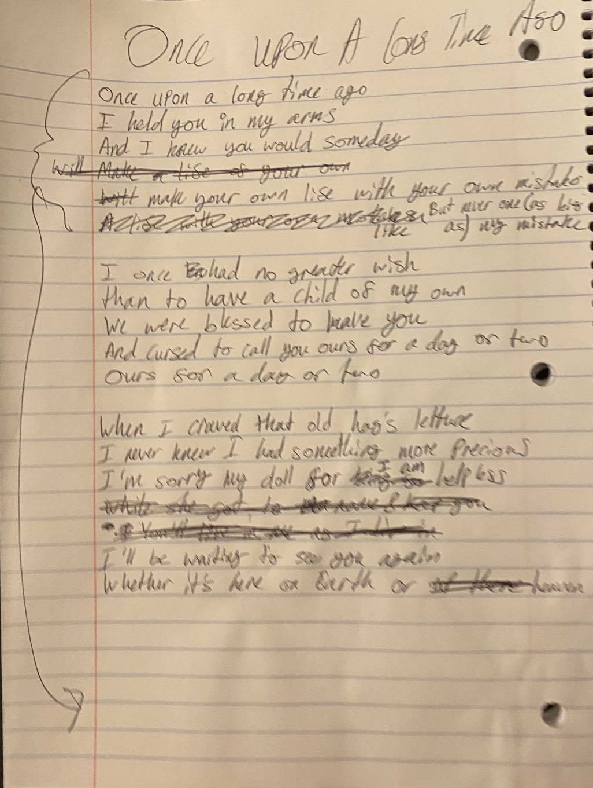
“Once Upon A Long Time Ago
This lullaby is from the perspective of Rapunzel’s biological mother, based on the song “Constant As The Stars Above” from Barbie as Rapunzel.
⇒

Slide 7
For the second part of my project, I created a poster from the perspective of the sorceress/Mother Gothel. This double-sided poster is meant to market her garden of fresh vegetables, only accepting payment as first-borns. The first page of the poster has the words, “Real love lasts a lifetime” above the terms and conditions. This line portrays how Mother Gothel sees her relationship with Rapunzel. For allowing the biological parents to have a lifetime supply of rapunzel lettuce, she was to have a lifetime with Rapunzel. In other words, Gothel's relationship with Rapunzel is similar to that of an overprotective mother to her child. As she believes Rapunzel is hers, she will not let Rapunzel out of her sight, never give her away to anyone else. This is further emphasized by the text at the bottom, “Children grow and leave. These [vegetables] keep growing.” This claims that the child’s act of leaving is proof the child does not love the parent the same way they did the child. However, the more love you put into these vegetables, the more they will grow - they will never leave and if they die they will simply grow back. Similar to the idea of an eternal child.
For the background of the first page, I put an image of rapunzel lettuce to symbolize how Rapunzel did exactly as the text says. She grew up and left Mother Gothel, first emotionally, then physically.
⇒

Slide 8
For the second page, I divided the page into two sections. The one on the right is dried wasteland, where nothing can ever grow. There is a picture of a poor woman with a baby looking mournfully over to the left side of the page - where Mother Gothel’s garden is. Contrastingly, this side of the image is lush with several plants and vegetables as well as a woman in red with no clear features holding a head of lettuce. I used bright colors here (as compared to the right side) to indicate how much is growing on this side, and how attractive the garden would look to those who are living in poverty. Moreover, the woman in red is meant to symbolize Mother Gothel. Her figure is all red - both the color of hunger and danger. She has no clear features due to the fact that no one truly knows her - she is this mysterious “hag” who has this beautiful garden that she may be willing to share but for a steep price. Her story, who she is is still unknown.
{Click here to return to choices}
{Click here to end}

Slide 9
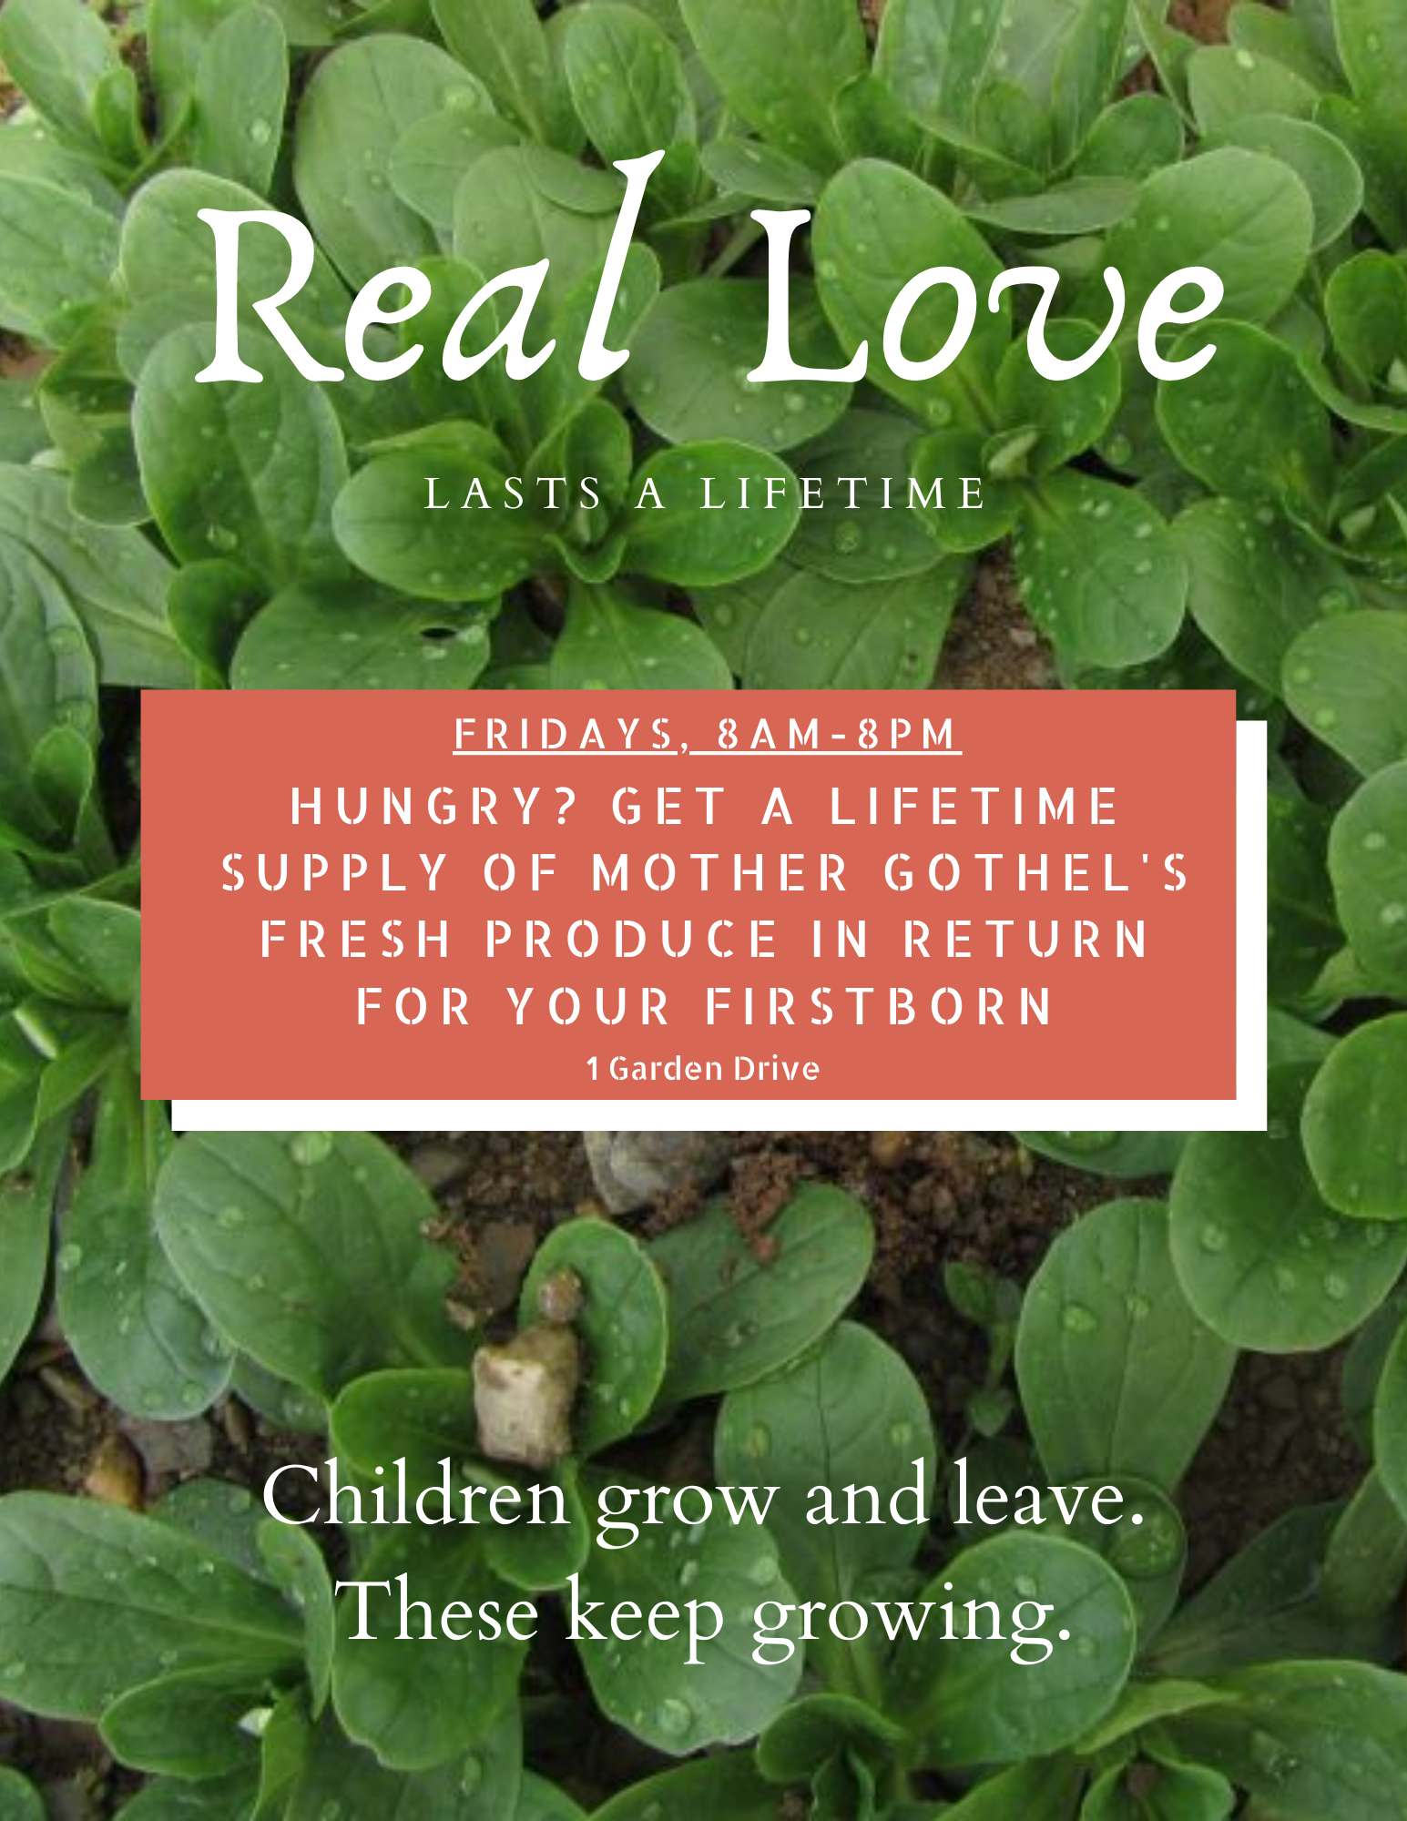
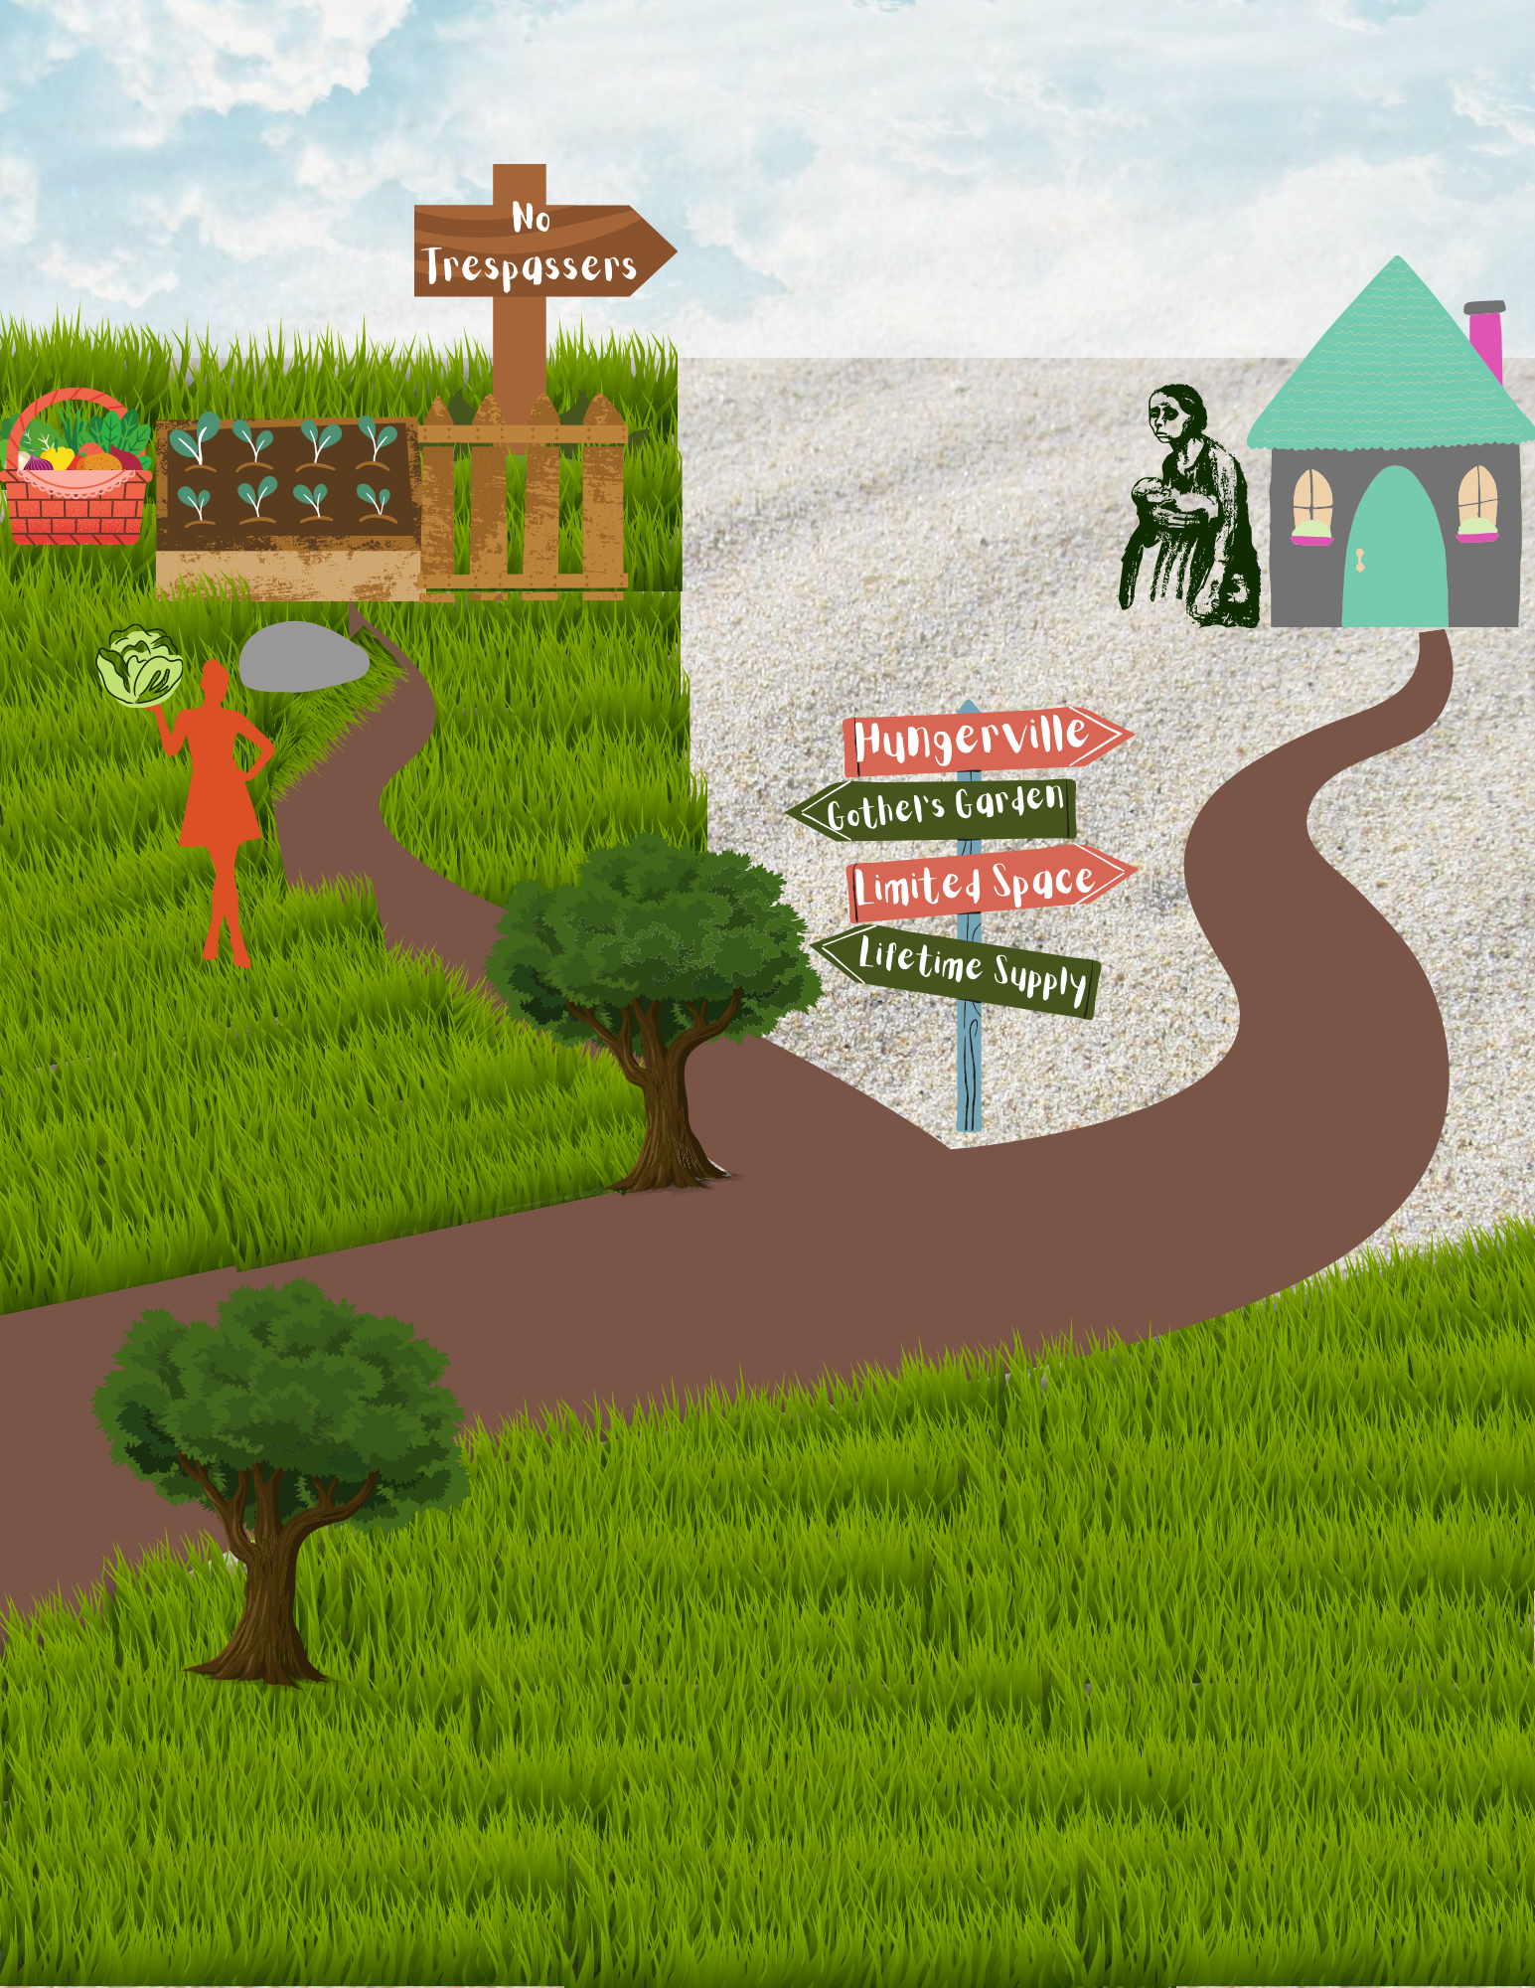
⇒

Slide 10
The third part of my project was to rewrite the song “Constant as the Stars Above” to fit the perspective of Rapunzel’s biological mother - showcasing her regrets and love for her daughter. I use this song in particular as this is the song that is shown in the movie Barbie as Rapunzel as a lullaby sang by Rapunzel’s mother to her. As readers, all we know of Rapunzel’s mother is that she was willing to exchange a daughter for lettuce - a daughter that she prayed years for. As a result, in some ways, she is the true villain of the story. If it hadn’t been for her and her husband’s actions, Rapunzel would not have been locked in that tower for so long. However, I believe that at some point she would have recognized her mistake and wished she could turn back time. Thus, she sings this lullaby to the child she lost all too soon. Therefore, I use that lullaby as the background music to the song I rewrote as, “Once Upon A Long Time Ago.”
⇒

Slide 11
This song serves to tell Rapunzel just what had happened, and how sorry her mother is. It runs through the events (“I once had no greater wish than to have a child of my own”) and ends with a hope to reconcile with her daughter, alive or dead. In the chorus, however, there is one line where the mother hints at the mistake that Rapunzel makes in telling Mother Gothel of the prince by singing about how Rapunzel will make mistakes just as she made hers, but she hopes it will never be one as great as her mistake.
{Click here to return to choices}
{Click here to end}

Slide 12
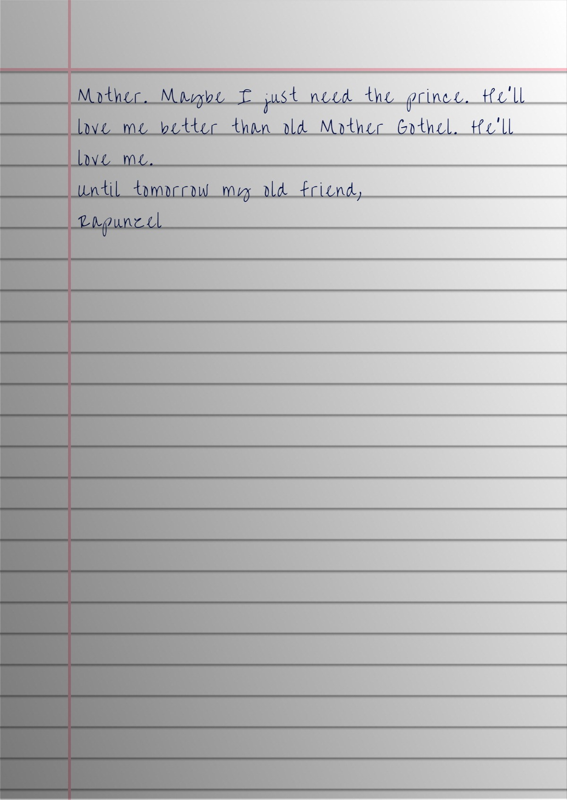
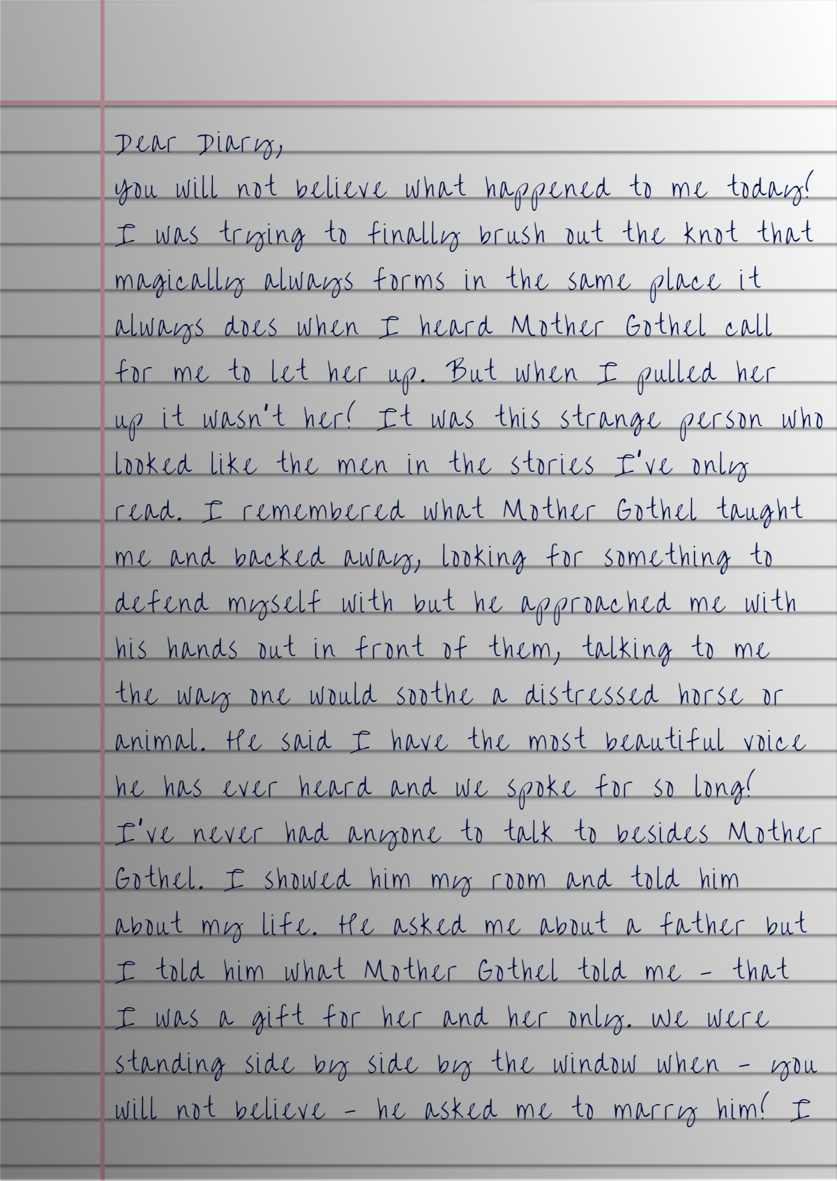
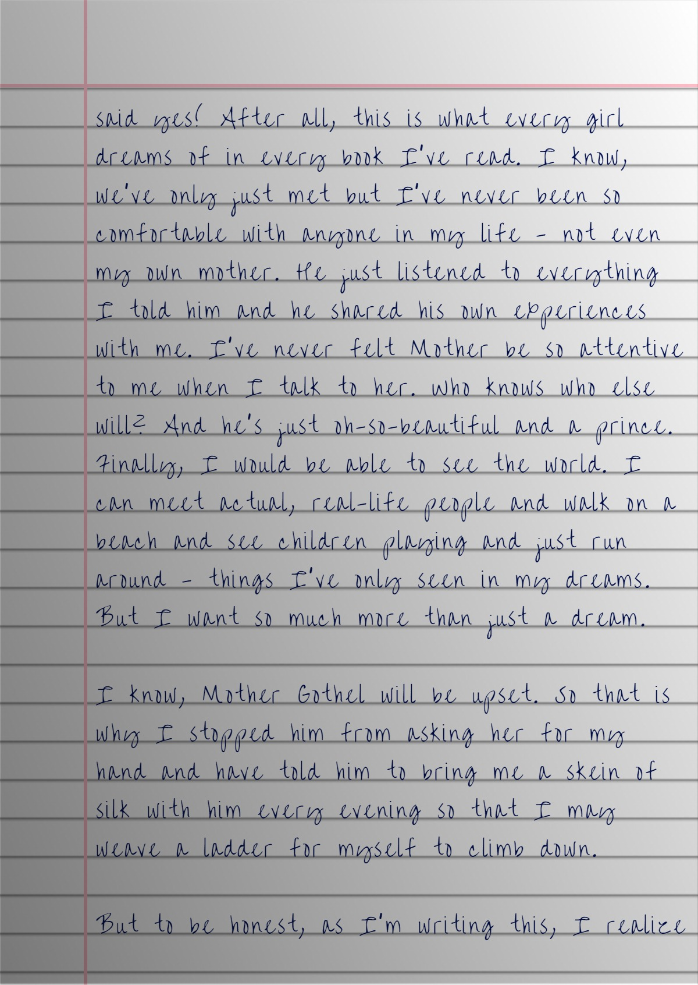
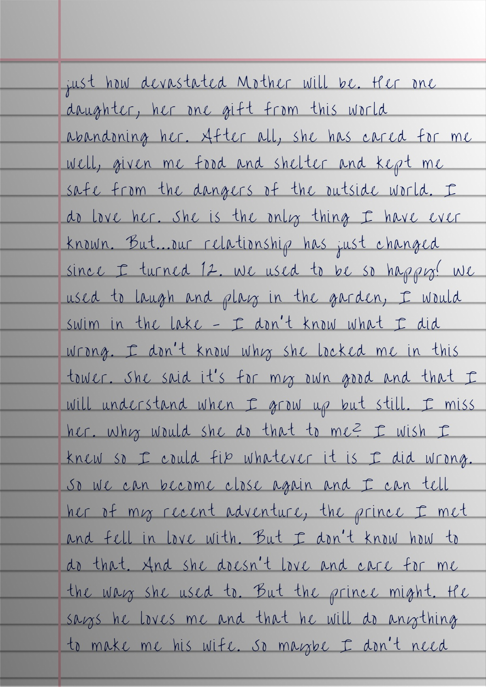
⇐ Pages 1 & 3
Click right to see next pages
Pages 2 & 4 ⇒
⇒

Slide 13
The last part of my project was creating a dish that I believed represented Rapunzel’s situation. I made a cheddar and monterey jack cream fettuccine to portray Rapunzel (her hair). I hollowed out part of a baguette from which the hair could fall out of. Surrounding the tower, is a garden of greens and flowers. Surrounding this garden, is a thorn “fence” of crumbled baked baby spinach. On the side is a ladder (woven with silk shein) of string cheese.
The first choice I made when decorating the dish was the fact that Rapunzel’s hair does not reach the bottom here. This is to portray the fact that while Rapunzel has a taste of freedom, an idea of what it would be like, she is still far from it, still too sheltered. What she is able to see out of her window is not the whole world - it is simply a small part of reality.
All Rapunzel can see from her tower is this garden full of greens and flowers. I place flower petals on top of the greens to symbolize how this garden is still a part of her innocence. As long as she is inside this garden and tower, she is still naive and young. Although her growth into adulthood has started, it has not been completed. Thus, the very few flower petals that are left in the garden seek to showcase this remaining innocence of hers.
⇒

Slide 14
The moment she steps out of the garden, she would be met by thorns - the very thorns that took away the eyesight of the prince. These thorns are meant to symbolize the first trial she would face going into adulthood - as she walks through the very fence that once protected her, she would be met with pain. As much as she may want to turn back to the place she has always known, she cannot. In order to escape and reach the other side to freedom, she must experience this pain.
It is important to note that the “silk” ladder does not reach the top. My goal was to symbolize how close Rapunzel is to her freedom, but it was by her doing she was unable to escape. In the dish, it is that the ladder she wove is too small to truly make a difference. I try to portray how there may be a reason she sabotages her own plan. As much as she craves freedom, the moment she is given a chance to experience it, she is afraid of what truly lies out there. All her life, she has only known shelter and protection and now must head to out to the world on her own - much like a child, 17 heading for college. Thus, she is torn on whether or not to leave.
{Click here to return to choices}
{Click here to end}

Slide 15
Thanks!

